Slide 1

Buffer Tree
Muhammad Sabihul Hasan¹, Agha Syed Nasir Mahmood Azeemi²,
Salman Muhammad Younus³, Syed Hammad Ali⁴, Muhammad Faraz Ozair⁵
^{Habib University}
1

Slide 2
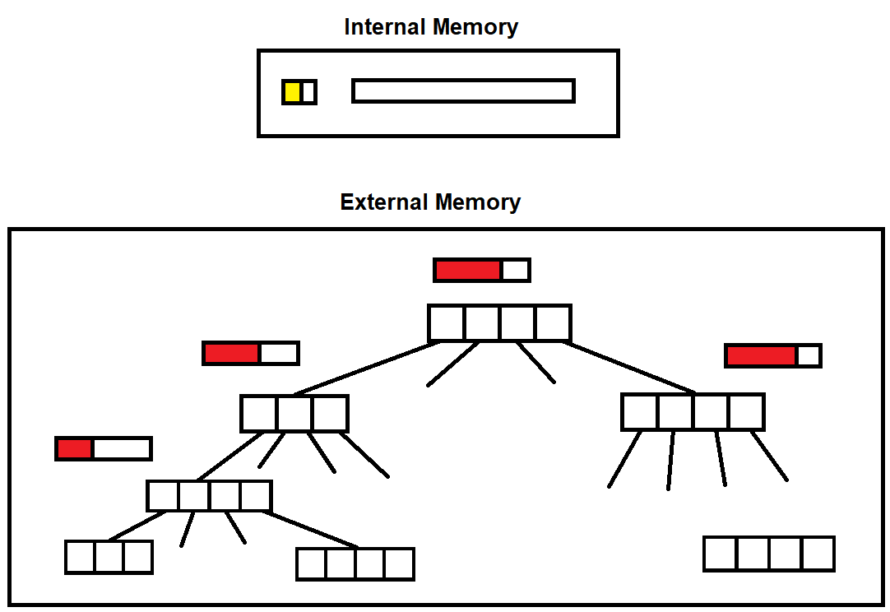
Previous work, challenge, and approach
Possible contents for slide
Clearly identify the challenge you are solving
Explain previous work (put your research in context)
Fundamental information or terms needed
Your strategy for overcoming the challenge
2

Slide 3
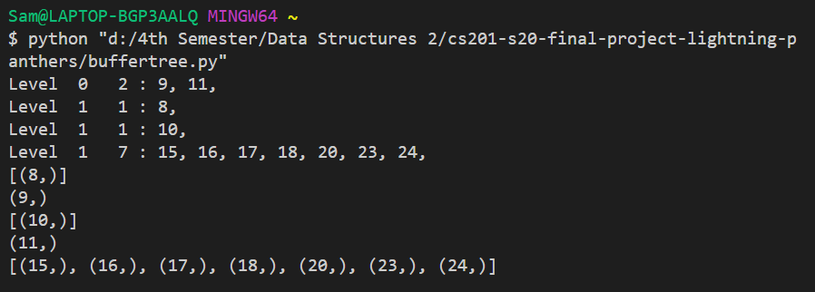
Implementation using Python lists
Operations:
Tree = Buffertree(min degree per node)
Tree.bufferinsert(element, operation)
where operation = [insert, delete, search]
Tree.print_tree(root_node)
Tree.inorder(root_node)
Time Complexity
3

Slide 4
Results and Conclusions
Possible contents for slide
Primary experimental data proving hypothesis
Key take-home message
4

